Slide 1
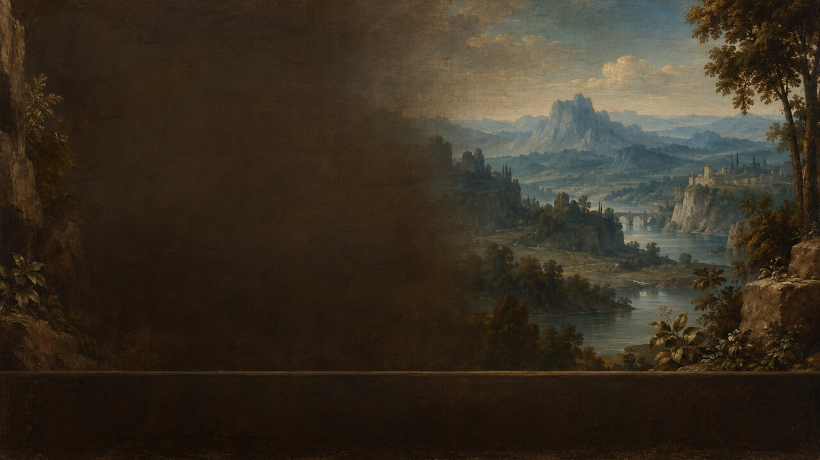
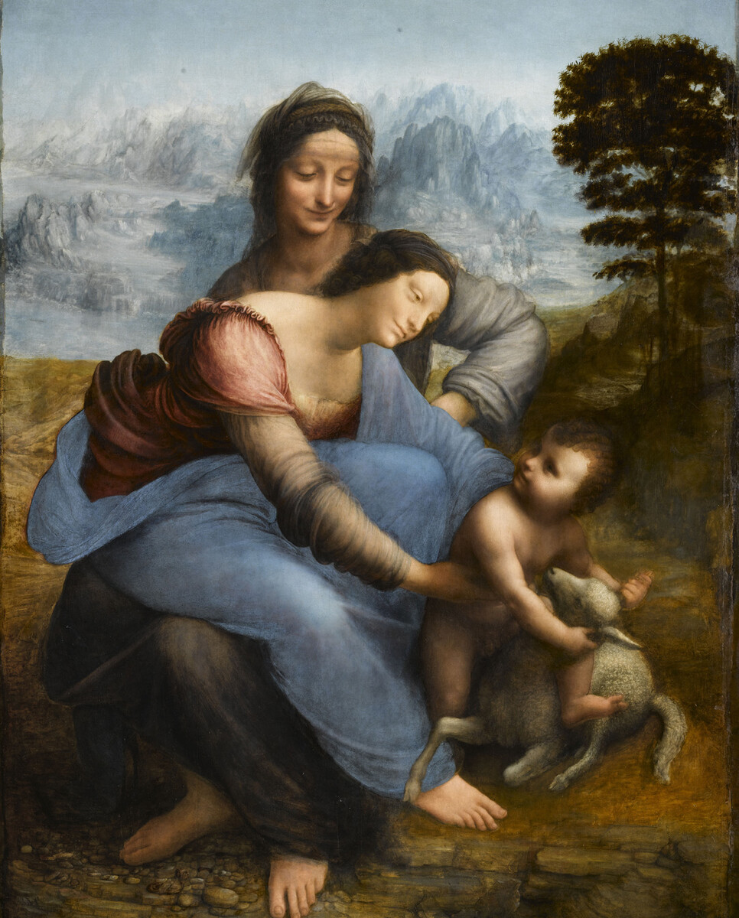
OUR FAMOUS ARTISTS | LEONARDO DA VINCI | c.1503–1519
Is She Protecting Him—or Letting Him Go?
THE VIRGIN AND CHILD WITH SAINT ANNE
A lamb turns a tender family scene toward a destiny no mother can prevent.
Notes:
When a mother sees her child moving toward danger, surely she pulls him back. Yet in Leonardo da Vinci’s The Virgin and Child with Saint Anne, Mary reaches forward and leans toward Jesus without fully stopping him.
The child plays with a lamb. To a Christian viewer, however, the lamb also evokes the Lamb of God and Christ’s future sacrifice. A gentle family scene therefore becomes an unsettling question: is Mary trying to protect her son, or learning to accept a destiny she cannot prevent?
Leonardo offers no written answer. He lets arms, glances, smiles, and interlocking bodies hold love, resistance, and surrender together.
[Sources]
- https://collections.louvre.fr/en/ark:/53355/cl010066107

Slide 2
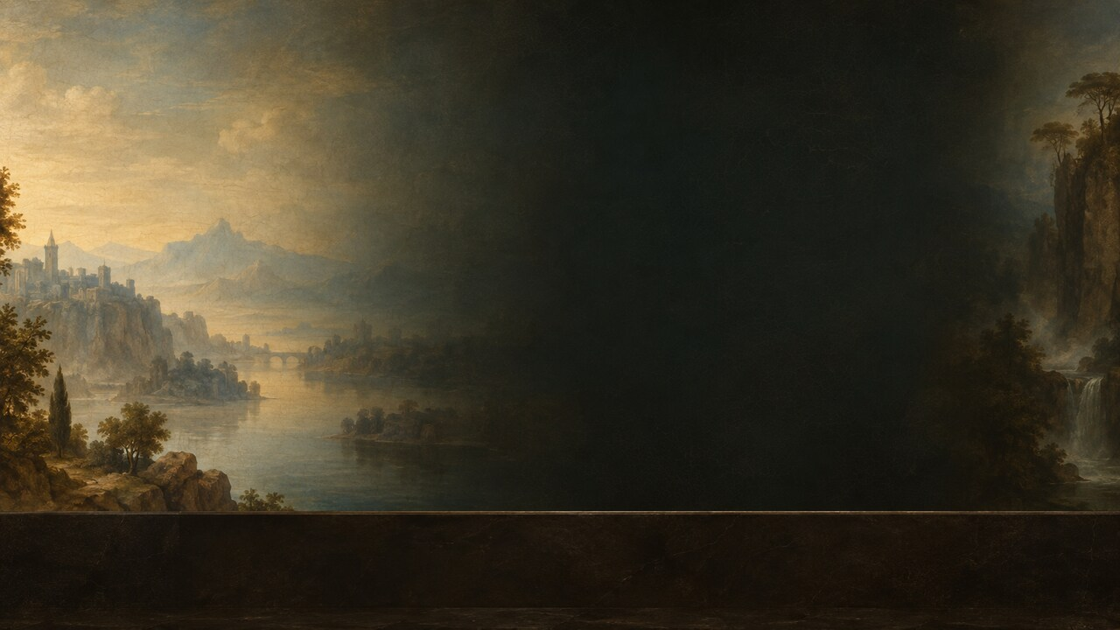
OUR FAMOUS ARTISTS | LEONARDO DA VINCI | c.1503–1519
02
What Are We Looking At?
OBJECT DATA
c.1503–1519
Oil on poplar
Louvre｜INV 776
CENTRAL QUESTION
Is Mary pulling her child back—or allowing him to move forward?
Oil on poplar｜about 168 × 130 cm｜Louvre INV 776
Notes:
The Louvre dates Leonardo’s painting to about 1503–1519. It is oil on a poplar panel, now approximately 168 centimeters high and 130 centimeters wide, and carries the inventory number INV 776.
It hangs in the Grande Galerie on the first floor of the Denon wing, beside the room containing the Mona Lisa. If the Mona Lisa concentrates mystery within one face, Saint Anne distributes uncertainty across four bodies: Anne, her daughter Mary, the Christ Child, and a lamb.
This was not a picture completed in a single campaign and delivered. Leonardo adjusted figures, drapery, and landscape over many years. When he died in 1519, parts of the foreground and terrain remained visibly unfinished. The painting is both a masterpiece and the record of an extended working process.
[Sources]
- https://collections.louvre.fr/en/ark:/53355/cl010066107

Slide 3
OUR FAMOUS ARTISTS | LEONARDO DA VINCI | c.1503–1519
03
A Family Portrait That Could Never Have Happened
01
SAINT ANNE｜the anchor
02
MARY｜between holding and release
03
CHRIST｜movement toward the future
The generations are not aligned; they form a current.
Anne, Mary, Christ, and the lamb compress lineage and salvation into one instant.
Notes:
Saint Anne is Mary’s mother and Christ’s grandmother. Some traditions held that Anne died before Christ’s birth, so this gathering is not ordinary family history. It is a theological construction that brings lineage, motherhood, and redemption into the same space.
Anne sits higher and farther back. Mary appears almost to sit across her mother’s lap while leaning forward. Christ twists toward the lamb below. The generations are not displayed side by side; movement seems to pass from Anne to Mary, and then from Mary to Jesus.
The oldest figure is the most stable. The mother is suspended between holding and releasing. The child moves most energetically toward the future. Leonardo compresses years of family and sacred history into the bodily rhythm of a single second.
[Sources]
- https://collections.louvre.fr/en/ark:/53355/cl010066107

Slide 4
OUR FAMOUS ARTISTS | LEONARDO DA VINCI | c.1503–1519
04
Why Does an Impossible Pose Feel Natural?
ANNE｜anchor
MARY｜hinge
CHRIST｜outward motion
STABLE SHAPE × CONTINUOUS MOTION
Inside a stable pyramid, bodies rotate, lean, and reach.
Notes:
At first, the figures form a stable pyramid, with Anne’s head at the summit and Mary and Christ expanding below. Look longer, however, and Mary’s position becomes surprisingly strange. She seems to sit across Anne’s legs, rotate her pelvis, lean forward, and extend both arms in another direction.
Leonardo did not organize the body according to an ordinary seated pose. Every joint serves the narrative. Anne supplies the stable anchor; Mary becomes the active hinge between generations; Christ carries the accumulated movement toward the lamb.
Sfumato softens the boundaries so that the bodies merge through subtle transitions of light and shade. A pose that is highly artificial, even nearly impossible, begins to feel graceful, continuous, and alive.
[Sources]
- https://collections.louvre.fr/en/ark:/53355/cl010066107

Slide 5
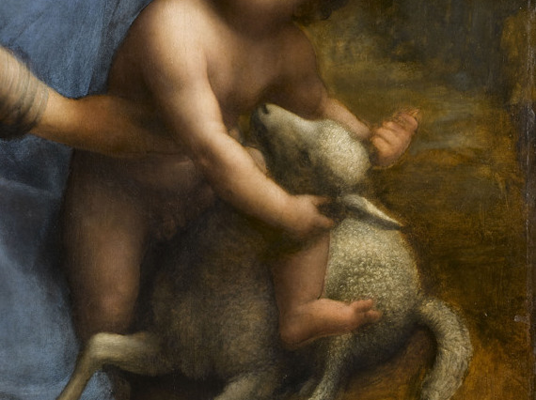
OUR FAMOUS ARTISTS | LEONARDO DA VINCI | c.1503–1519
05
The Lamb: Play, Embrace, or Passion?
01
Childhood play
02
The Lamb of God
03
A forecast of the Passion
Christ seems to play—and to embrace the symbol of future sacrifice.
Notes:
Jesus does not sit quietly in Mary’s arms. He presses against or straddles the lamb, holds its neck, and turns with the energy of a child at play. Yet the lamb had long represented the Lamb of God—Christ offered in sacrifice.
Leonardo therefore places the future inside a childhood game. Jesus seems both to embrace the lamb and to accept what it signifies. Mary’s approaching hands can be read as an effort to pull him away, or as hesitation between maternal love and obedience.
There is no cross, blade, or blood in the painting, but the Passion is already present. It has been condensed into the small distance between a mother’s fingers and a child she cannot quite reclaim.
[Sources]
- https://collections.louvre.fr/en/ark:/53355/cl010066107

Slide 6
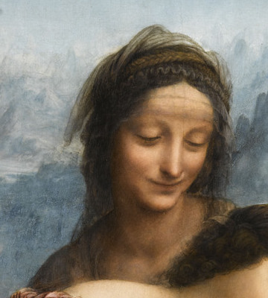
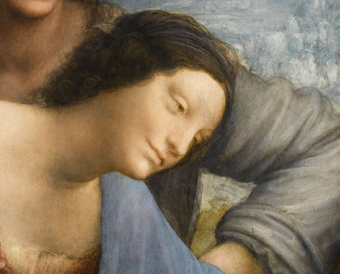
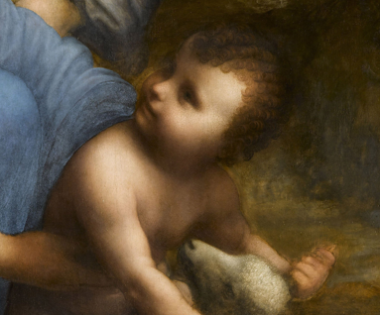
OUR FAMOUS ARTISTS | LEONARDO DA VINCI | c.1503–1519
06
Three Faces, Three Kinds of Time
SAINT ANNE
MARY
CHRIST
ANNE｜calm
MARY｜tenderness and anxiety
CHRIST｜looking back, moving on
Anne’s long order, Mary’s present tension, and Christ’s future movement.
Notes:
Anne watches her daughter and grandson with a calm, elusive smile. Mary is absorbed in the child’s movement, expressing tenderness but perhaps also anxiety. Jesus turns back toward his mother even as his body continues toward the lamb.
The three faces seem to inhabit different times. Anne may suggest a longer sacred order; Mary occupies the immediate tension of maternal love; Jesus moves physically toward the future.
Still, no document proves that Leonardo intended Anne to be the one who “already knows.” What he gives us is a precise choreography of glances and expressions that remain open enough for affection, sorrow, understanding, and submission to coexist.
[Sources]
- https://collections.louvre.fr/en/ark:/53355/cl010066107

Slide 7
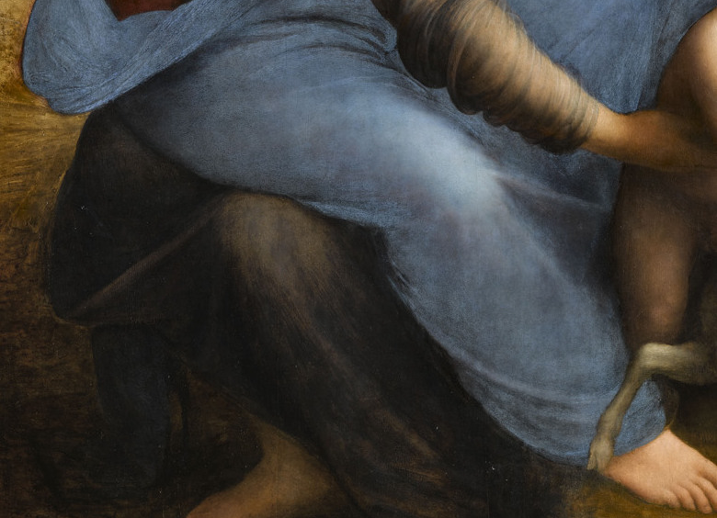
OUR FAMOUS ARTISTS | LEONARDO DA VINCI | c.1503–1519
07
Are There Really Only Three Legs?
OBSERVE
Readable legs
Overlapping blue mantle
Unresolved paint
“Three legs = Trinity” is a later association, not a decoded secret.
Overlapping drapery and unfinished paint explain more than a secret code.
Notes:
Many viewers notice that the two adult women seem to possess only three clearly readable legs. Some then connect the number three to the Trinity and treat it as a hidden Leonardo code.
A more direct explanation lies in the overlap of Mary’s blue mantle, Anne’s drapery, underlying lines, and incompletely resolved paint. Leonardo left no statement identifying a deliberate three-legged design, and technical evidence does not establish one.
The integration of three generations into an almost indivisible group may certainly evoke a visual sense of “three in one.” But that is a later theological association, not a secret that scholarship has conclusively decoded.
[Sources]
- https://collections.louvre.fr/en/ark:/53355/cl010066107

Slide 8
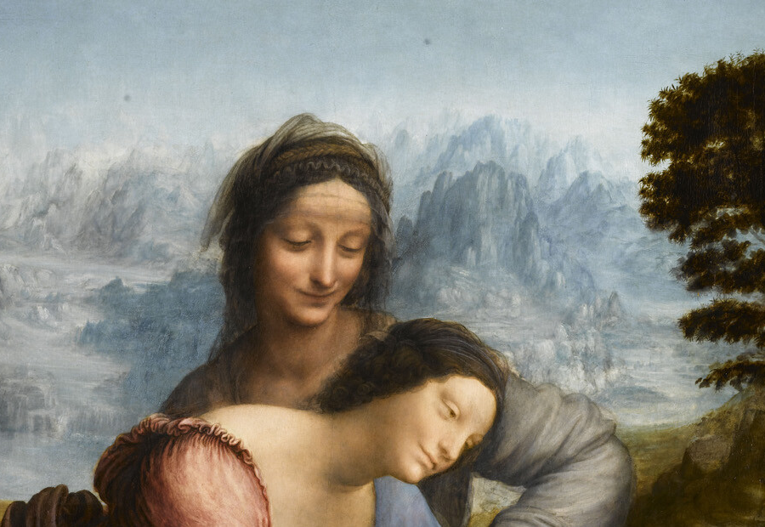
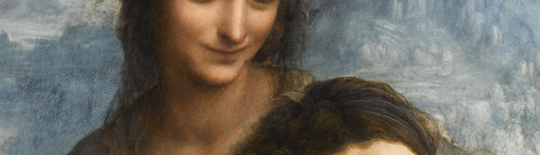
OUR FAMOUS ARTISTS | LEONARDO DA VINCI | c.1503–1519
08
Sfumato: Emotion Still Forming
PAINTING THROUGH AIR
SFUMATO｜weakened edges
ATMOSPHERE｜blue distance
EMOTION｜kept open
Edges dissolve into air, leaving emotion without a fixed verdict.
Notes:
Leonardo’s sfumato is not simply blur placed around the figures. Fine tonal transitions weaken fixed contours. Cheeks dissolve into shadow, mouths lack a hard line that could lock an emotion in place, and arms and drapery seem to emerge gradually through air.
That is why Anne and Mary cannot be classified simply as smiling or grieving. Emotion appears as an ongoing formation rather than a completed statement.
The landscape uses atmospheric perspective: distant mountains become bluer, lighter, and less distinct. Rocks and water also reflect Leonardo’s long interest in geology and natural movement. The figures do not sit like cut-outs before a background. Body, air, and terrain seem to participate in one slow current.
[Sources]
- https://collections.louvre.fr/en/ark:/53355/cl010066107

Slide 9
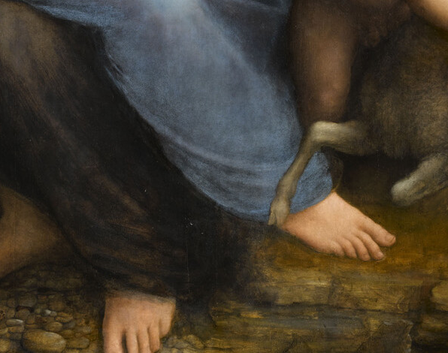
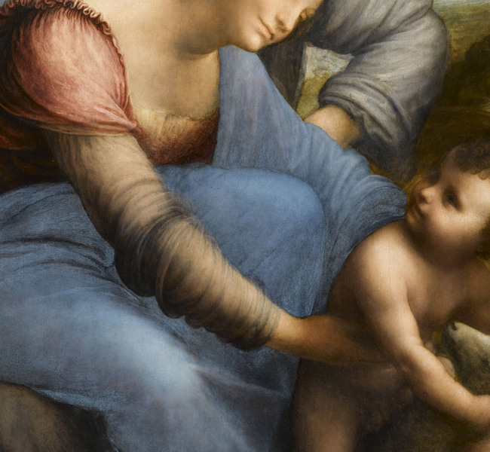
OUR FAMOUS ARTISTS | LEONARDO DA VINCI | c.1503–1519
09
A Finished Masterpiece—and an Unfinished Painting
DIFFERENT STAGES
REFINED｜faces and hands
ROUGH｜landscape and foreground
REVISED｜drapery, hair, gesture
LANDSCAPE STILL FORMING
Different levels of finish preserve thought inside the paint.
Notes:
The faces, hands, and parts of the clothing are astonishingly refined. Yet the foreground, rocky stream, and middle ground between the figures and blue mountains remain substantially unfinished. This is not simply the result of later damage; the painting itself stopped at different stages.
Infrared reflectography, X-rays, ultraviolet fluorescence, and material analysis show that Leonardo continued to revise drapery, hairstyles, gestures, and relationships after painting had begun. He did not finish a perfect drawing and merely fill it with color. Thought continued inside the paint layers.
The work is therefore both image and laboratory. Areas that were never fully covered allow us to watch an artist repeatedly refuse his previous answer.
[Sources]
- https://c2rmf.fr/actualite/la-sainte-anne-une-restauration-majeure

Slide 10
OUR FAMOUS ARTISTS | LEONARDO DA VINCI | c.1503–1519
10
Who Commissioned It? Two Stories Lack Proof
FLORENTINE CONTEXT
LIMIT OF EVIDENCE
SANTISSIMA ANNUNZIATA｜context
LOUIS XII｜older theory
DIRECT CONTRACT｜none found
CONTEXT IS NOT A CONTRACT.
The religious context is clear; the original contract for this panel is not.
Notes:
Vasari wrote that friars at Santissima Annunziata in Florence waited for Leonardo to develop a Saint Anne composition, and that a publicly displayed cartoon drew crowds for two days. The story shows that the design attracted enormous attention, but no surviving contract proves that the Louvre panel was the intended altarpiece.
Another older theory proposed that Louis XII commissioned the painting to celebrate the birth of his daughter Claude, partly because Queen Anne of Brittany shared the saint’s name. Current Louvre scholarship does not treat this as established evidence.
The most honest conclusion is that Saint Anne had strong religious visibility in Florence around 1500, and the painting later became connected with the French court. The original patron, however, remains uncertain.
[Sources]
- https://collections.louvre.fr/en/ark:/53355/cl010066107
- Giorgio Vasari, Lives, 1568

Slide 11
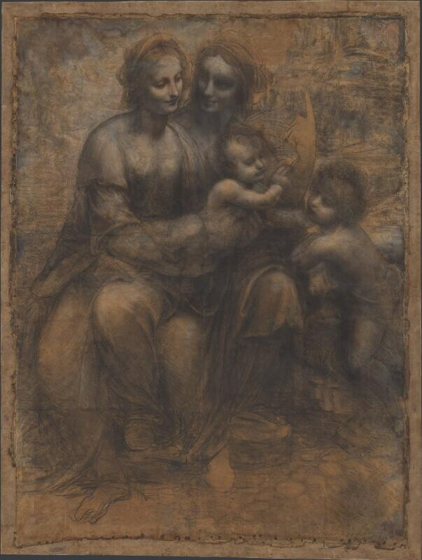
OUR FAMOUS ARTISTS | LEONARDO DA VINCI | c.1503–1519
11
Not One Cartoon, but Several Possible Roads
LOST
The lamb cartoon described in 1501
1501
c.1506–1508
c.1503–1519
Cartoon, lost design, and panel do not form one simple sequence.
Notes:
The National Gallery’s Burlington House Cartoon shows Anne, Mary, Christ, and the young John the Baptist—without a lamb. The museum currently dates it to about 1506–1508 and describes it as a full-scale presentation drawing rather than an ordinary transfer cartoon.
On 3 April 1501, Fra’ Pietro da Novellara described another Saint Anne cartoon that included a lamb. That sheet is lost. From the letter and later copies, scholars reconstruct a design in which Mary’s effort to restrain Christ, and Anne’s effort to restrain Mary, may have been more explicit than in the Louvre panel.
This is not a simple straight line, and not merely John replaced by a lamb. Leonardo repeatedly tested figures, orientations, and gestures. The surviving painting preserves one late state of a much longer process.
[Sources]
- https://www.nationalgallery.org.uk/paintings/leonardo-da-vinci-the-burlington-house-cartoon
- Fra’ Pietro da Novellara letter, 3 April 1501

Slide 12
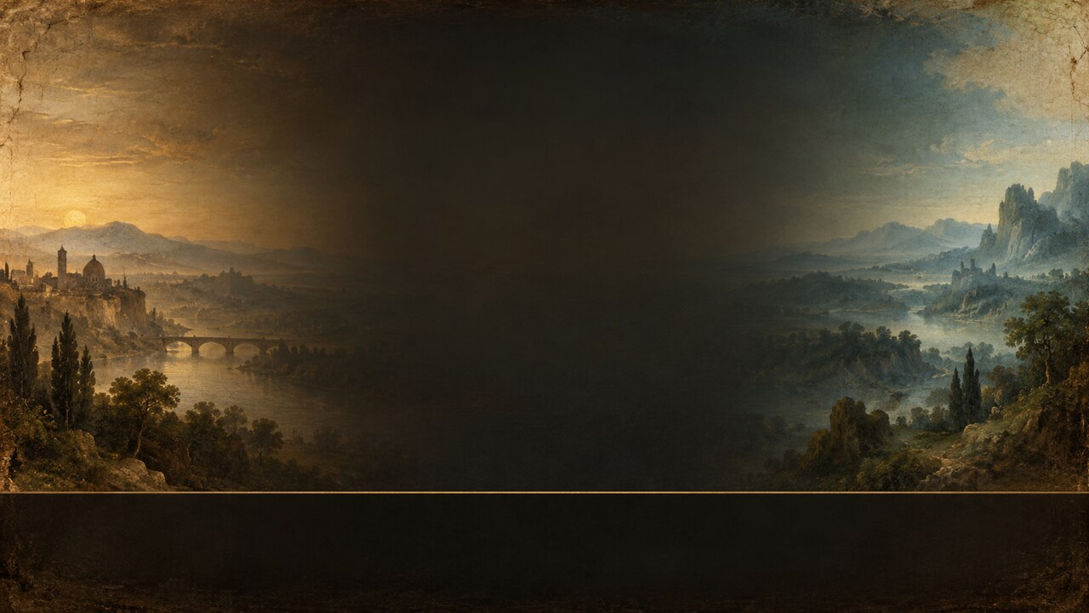
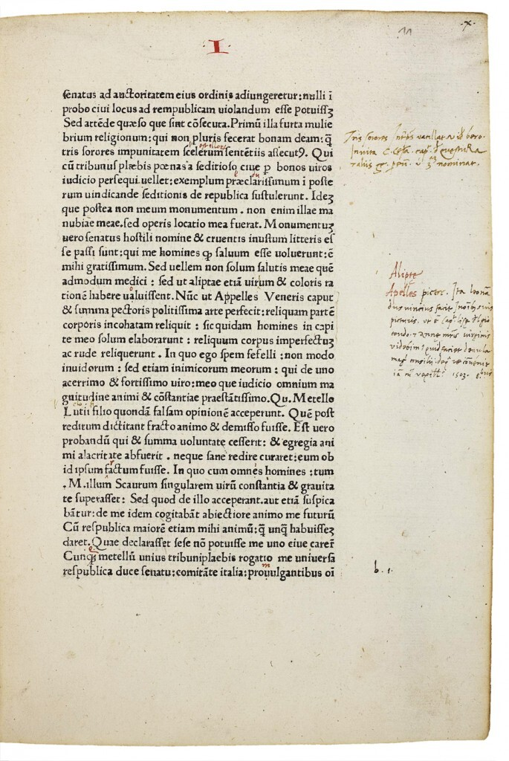
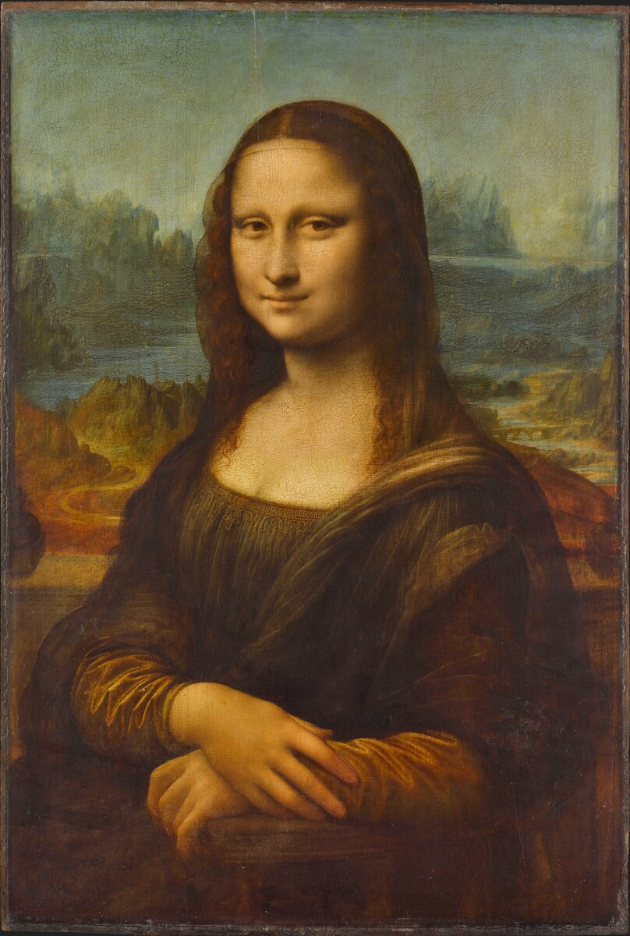
OUR FAMOUS ARTISTS | LEONARDO DA VINCI | c.1503–1519
12
A 1503 Note Links Saint Anne and the Mona Lisa
LISA ↔ ANNE
1503
A contemporary note places “Lisa” and “Anne” together in Leonardo’s working world.
Notes:
In 2005, scholars identified a note written in October 1503 by the Florentine official Agostino Vespucci in a volume of Cicero at Heidelberg University Library.
Vespucci compared Leonardo to the ancient painter Apelles and mentioned both the head of Lisa del Giocondo and the head of “Anne, mother of the Virgin.” This brief note gives the Mona Lisa and the Saint Anne project a rare contemporary coordinate.
It does not describe the entire composition or tell us which state of the painting existed. What it demonstrates is that by 1503, these two subjects—later among Leonardo’s most famous works—were already present together in his working life.
[Sources]
- https://www.uni-heidelberg.de/press/news/press536e.html
- https://collections.louvre.fr/en/ark:/53355/cl010066107

Slide 13
OUR FAMOUS ARTISTS | LEONARDO DA VINCI | c.1503–1519
13
Did Leonardo Carry It to the End of His Life?
1503
1517
c.1518
1683
1793
Panel begun
Seen at Clos Lucé
Likely royal acquisition
Royal inventory
Public Louvre
DOCUMENTS GIVE POINTS—NOT A COMPLETE ROUTE.
The painting was at Clos Lucé in 1517; its full route remains incomplete.
Notes:
Leonardo probably began the panel in Florence and continued to revise it while moving between cities. In 1516 or 1517 he settled in France. In October 1517, Antonio de Beatis recorded seeing a painting of the Virgin, Christ Child, and Saint Anne at Leonardo’s residence at Clos Lucé.
The Louvre considers it likely that Francis I acquired the work around 1518, but no complete sale contract survives. Large gaps remain after Leonardo’s death; a royal inventory of 1683 offers another clearer point in the history.
After the French Revolution, the royal collection became national property. When the Louvre opened to the public in 1793, the painting’s identity gradually shifted from a monarch’s possession to a work of public cultural heritage.
[Sources]
- https://collections.louvre.fr/en/ark:/53355/cl010066107

Slide 14
OUR FAMOUS ARTISTS | LEONARDO DA VINCI | c.1503–1519
14
Three Images Hidden on the Back of the Panel
REVERSE OF THE PANEL
WHAT IMAGING REVEALED
HORSE｜visible
SKULL｜infrared
CHILD｜author uncertain
HORSE
SKULL
CHILD
SEEING A MARK ≠ PROVING ITS AUTHOR
Horse, skull, child: real marks, but not all securely by Leonardo.
Notes:
Examination in 2008 and the conservation campaign begun in 2009 directed new attention to the back of the panel. Beyond a horse’s head already visible to the eye, infrared imaging revealed a skull and the figure of a child.
The lines demonstrate that the reverse was used for drawing, but they do not prove that all three images were made by Leonardo himself. The child should not be identified automatically as Christ with the lamb.
The uncertainty is part of the fascination. One of the most intensively studied artists in history could still leave unidentified lines on the back of a panel that had been viewed for centuries, waiting for scientific imaging to make them visible again.
[Sources]
- https://c2rmf.fr/actualite/la-sainte-anne-une-restauration-majeure

Slide 15
OUR FAMOUS ARTISTS | LEONARDO DA VINCI | c.1503–1519
15
2009–2012: What Did Conservation Reveal?
CONSERVATION & RESEARCH
CRITICISM & CONCERN
Ultramarine layers became clearer
Unfinished areas were identified
Some later overpaint was retained
Was the cleaning too deep?
Were white layers or glazes weakened?
Was some smoky softness lost?
VERDICT｜not simple
Scientific findings and criticism of overcleaning must remain side by side.
Notes:
From 2009 to 2012, the Louvre and C2RMF conducted a major conservation and research campaign. Cleaning made the complex ultramarine layers and color relationships in Mary’s garment more visible. Research also clarified unfinished areas, later overpaint, and the condition of the paint. Conservators did not simply remove every later intervention.
Critics including Ségolène Bergeon Langle and Jean-Pierre Cuzin worried that cleaning went too far, perhaps removing a white layer from Christ’s body or weakening the smoky effect created by Leonardo’s glazes.
It is therefore inaccurate to claim either that the painting was restored perfectly to its original state or that it was unquestionably ruined. Conservation revealed some relationships while sharpening an unavoidable question: after five centuries, what exactly counts as the original appearance?
[Sources]
- https://c2rmf.fr/actualite/la-sainte-anne-une-restauration-majeure
- https://journals.openedition.org/imagesrevues/9684

Slide 16
OUR FAMOUS ARTISTS | LEONARDO DA VINCI | c.1503–1519
16
Freud’s Vulture: One Word Went Wrong
nibbio
vulture
≠
KITE
VULTURE
EVIDENCE CHECK
FREUD｜two mothers NIBBIO＝KITE VULTURE＝AVVOLTOIO
Nibbio means kite, not vulture; a compelling theory began with a mistranslation.
Notes:
In 1910, Sigmund Freud connected the similarly aged Anne and Mary—the two mothers visually intertwined—with Leonardo’s separation from his birth mother and upbringing within his father’s household. This became the influential “two mothers” interpretation.
Freud also saw a vulture in Mary’s drapery and linked it to Egyptian maternal mythology. But the Italian word in Leonardo’s remembered passage, nibbio, means a kite, not a vulture. The translation mistake seriously weakened the vulture argument.
This does not make every connection between Leonardo’s life and the image’s multiple motherhood meaningless. It reminds us that even a compelling interpretation may rest on a mistaken word. Biography can open a route into the painting, but it cannot replace historical, iconographic, and material evidence.
[Sources]
- Sigmund Freud, Leonardo da Vinci and a Memory of His Childhood, 1910
- https://www.jstor.org/stable/2707740

Slide 17

OUR FAMOUS ARTISTS | LEONARDO DA VINCI | c.1503–1519
17
How Long Can Love Protect Someone?
Can protection have a limit?
Can letting go also be love?
Is the hand resistance—or blessing?
Leonardo does not answer. The gesture keeps asking.
Is the reaching hand resistance—or blessing?
Notes:
The Virgin and Child with Saint Anne appears to show three generations of a family. Beneath that surface, it compresses family, nature, salvation, and artistic creation into one suspended instant.
Anne does not clearly restrain her daughter. Mary reaches forward but does not take Jesus away. The child looks back toward his mother while his body continues toward the lamb. Everyone is joined by love, yet everyone is being carried toward the next moment.
Leonardo’s achievement is not to explain theology neatly, but to turn love itself into a question. Does protection have a limit? Can letting go also be an act of love? When we cannot walk another person’s path for them, does the hand we still extend mean resistance—or blessing?
Perhaps that is why the painting has refused to become quiet after five centuries. It does not remain safely inside a story about saints. It draws into the image everyone who has ever tried to protect, release, or lose someone they love.
[Sources]
- https://collections.louvre.fr/en/ark:/53355/cl010066107

Slide 18

Notes:
This is Our Famous Artists. If you enjoy looking again with evidence, subscribe and join us for the next masterpiece.
[Sources]
- Channel end card; no external sources.

